Slide 1
Salt identification
Group member:
minda Chen
yuxuan xiong

Slide 2
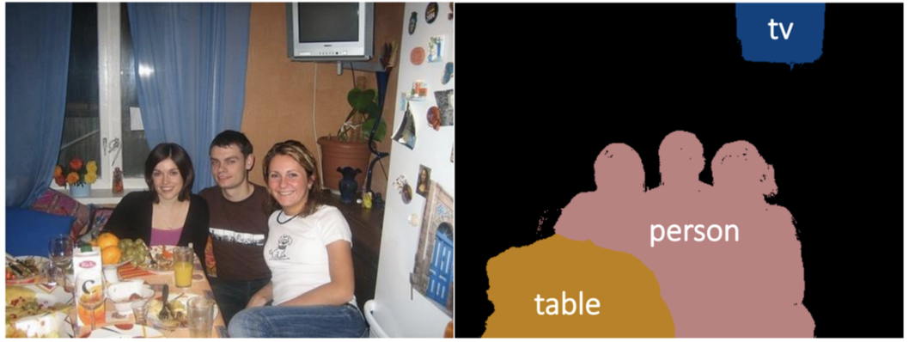
Image Segmentation
Output has same size with input
Each element in the output indicates the classification of corresponding pixel in the input

Slide 3
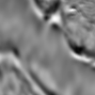

Objective
Build a CNN model to identify salt in seismic reflection images.
Input:
Output:
Seismic reflection images of subsurface containing salt and regular rocks
White = salt
Black = regular rocks
Framework : DL4J

Slide 4
What we have done
Built image process pipeline
Built U-net and Residual U-net models
Built Dataset/Model utilities for training/evaluating process
Built both local and spark version of training process
Built custom evaluators of IoU (Intersection over Union)
Built unit test for important components

Slide 5
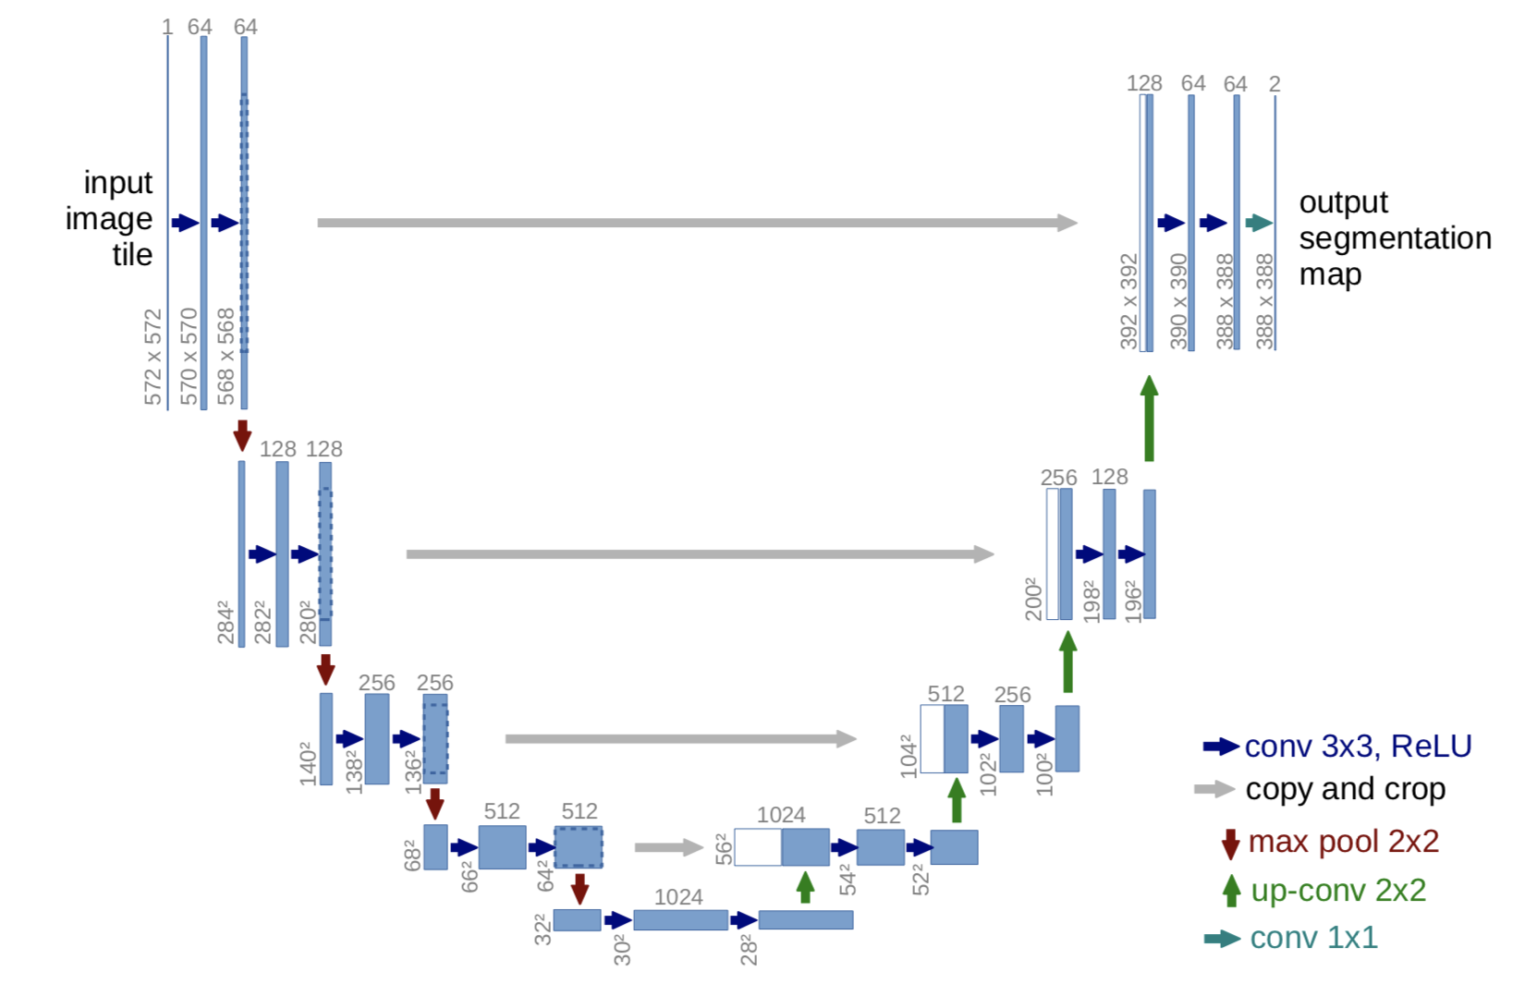
U-net

Slide 6
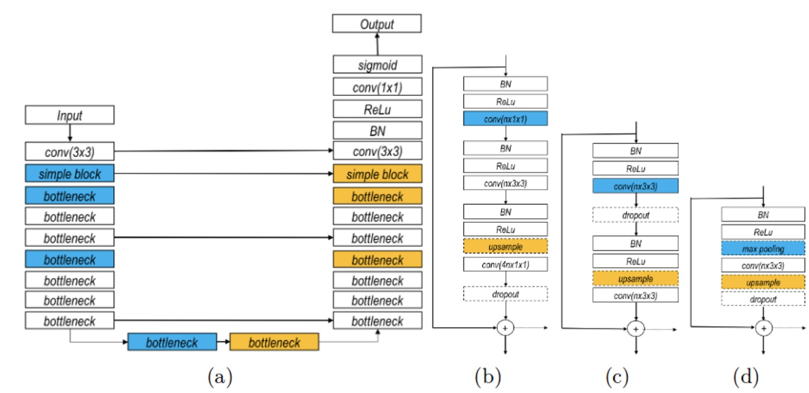
Residual U-net
Residual U-net
Bottleneck Block
(c) Basic Block
(d) Simple Block

Slide 7
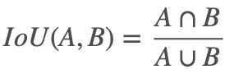
Evaluation
The IoU of a proposed set of object pixels and a set of true object pixels is calculated as:
Our goal:
Average IoU > 80%

Slide 8
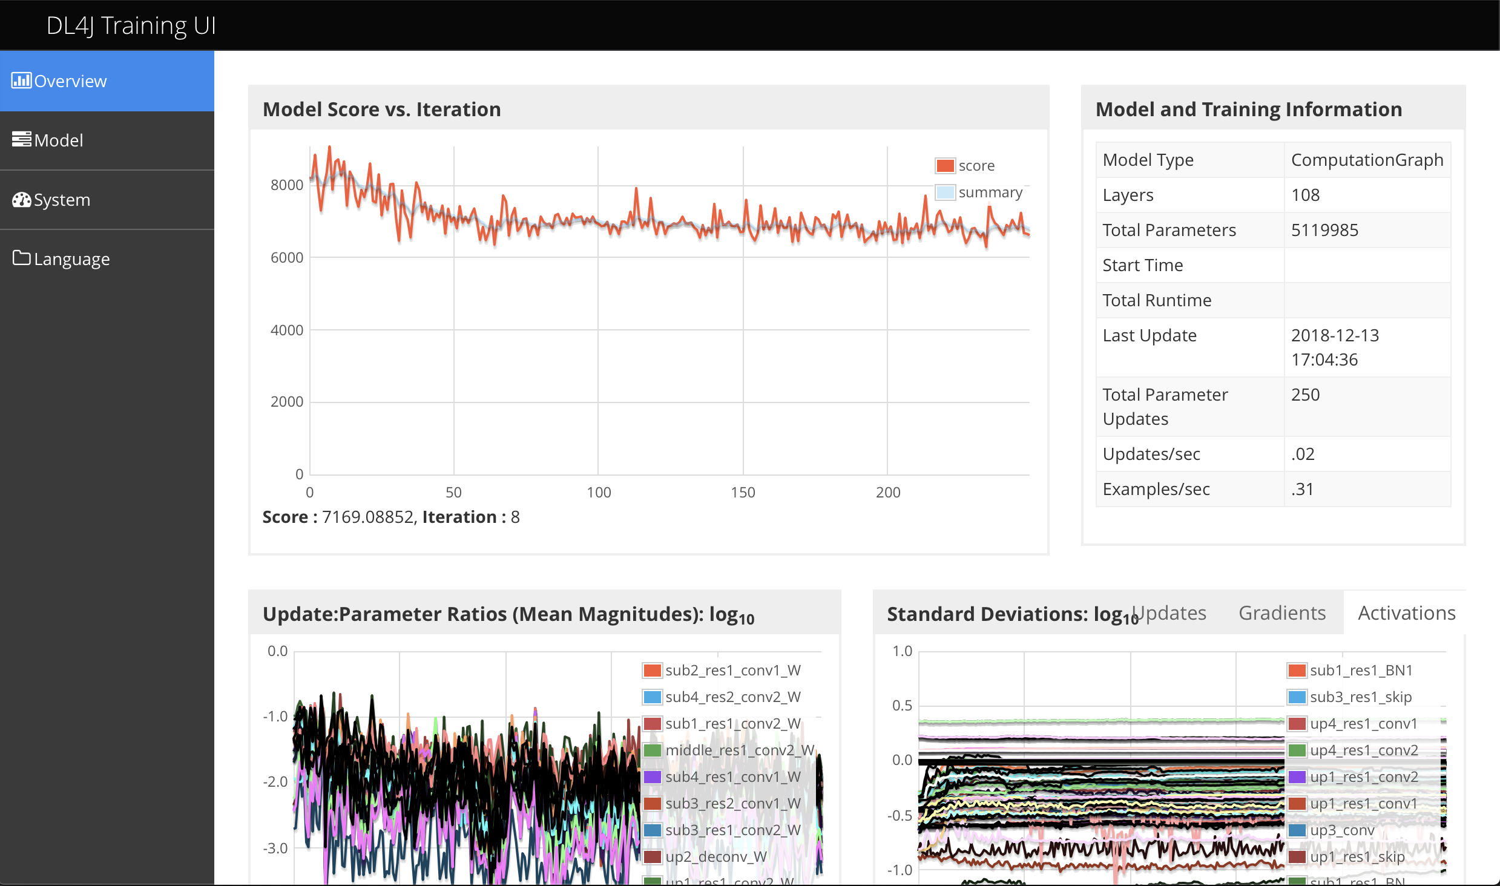
What Happened
Local training too slow : 4 hours per epoch
Got IoU of 64.52% after 5 epochs

Slide 9
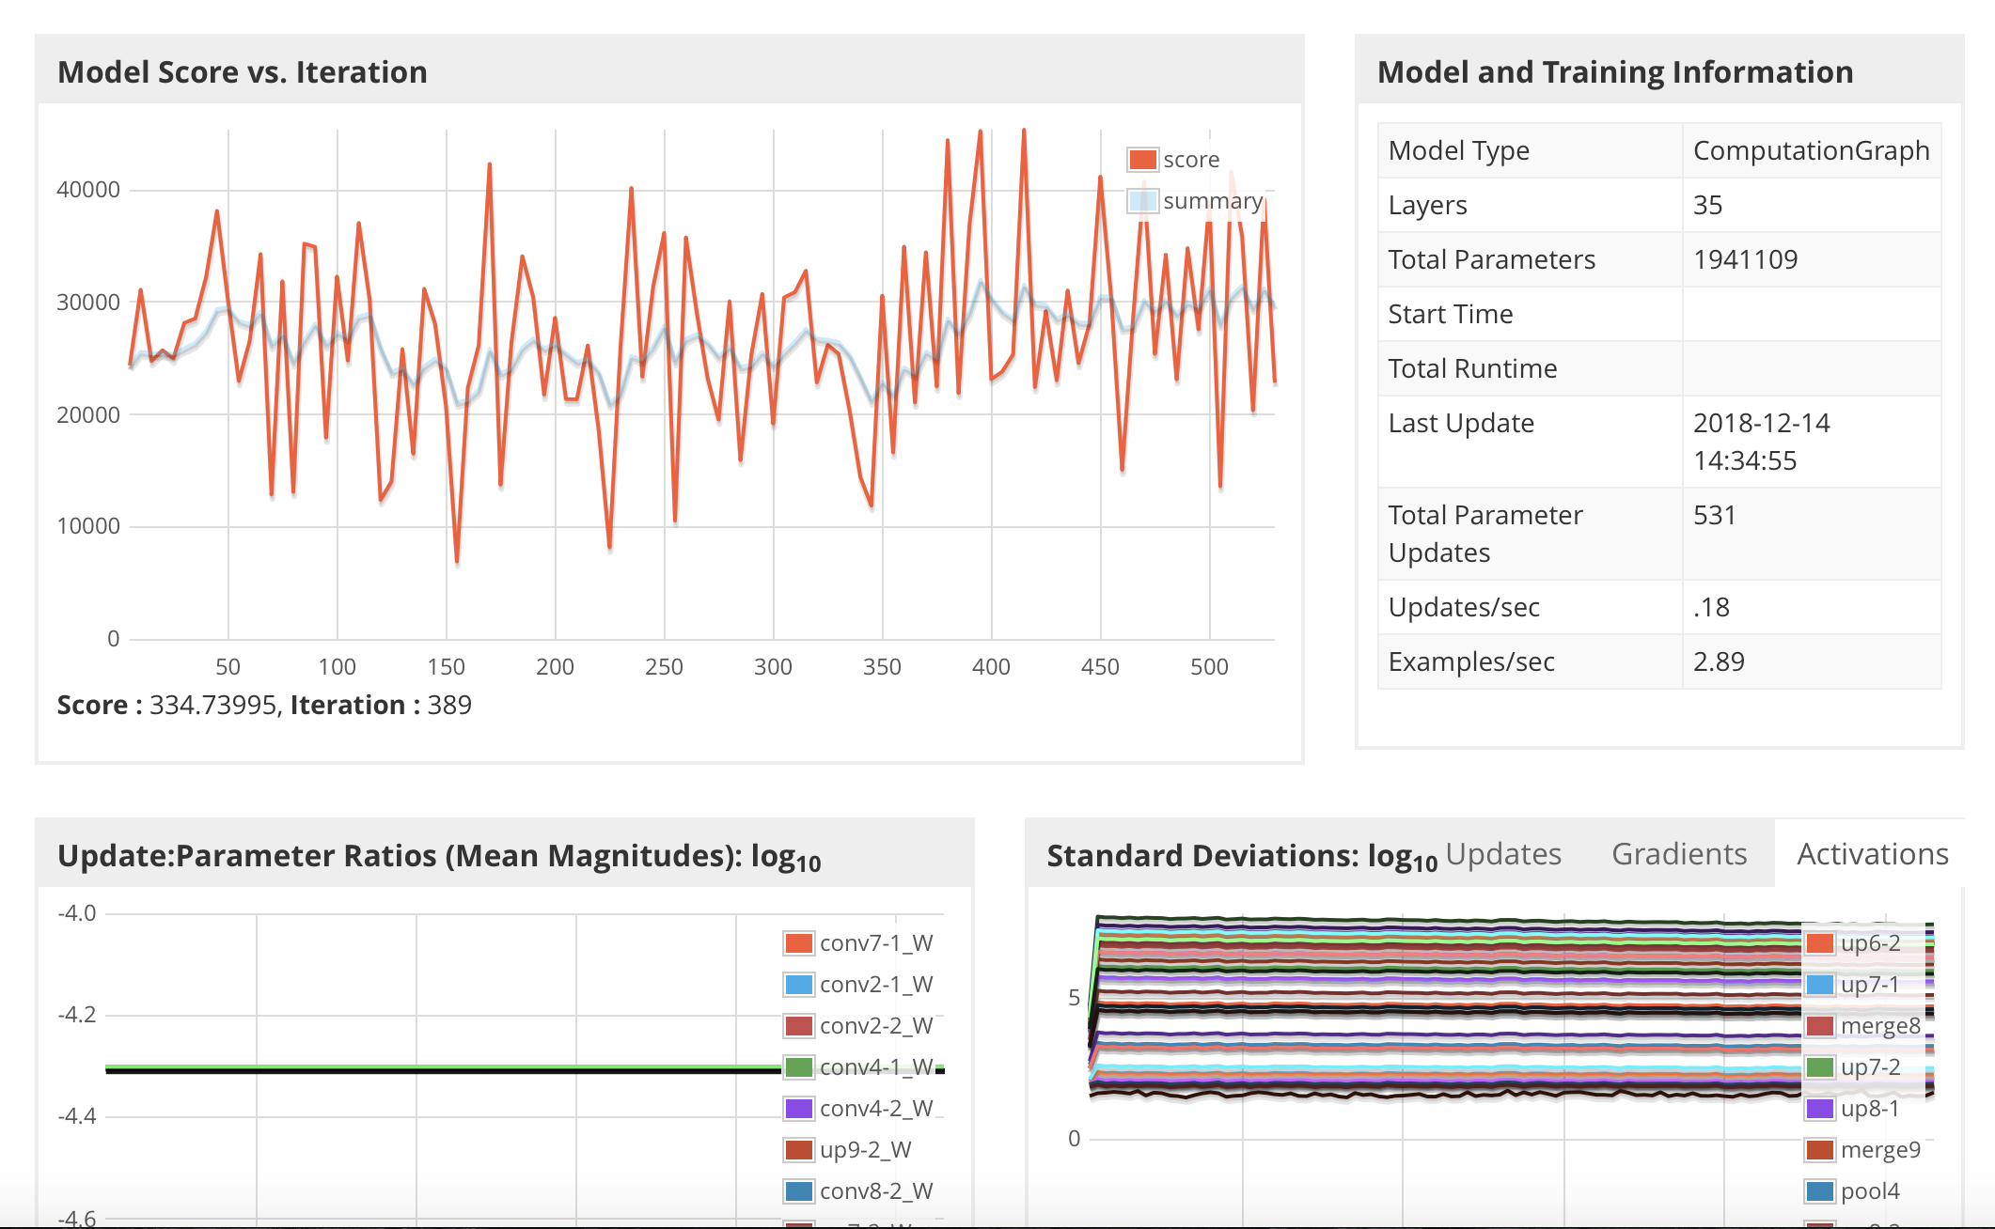
What Happened
Tried the UNET version, didn’t seem to converge

Slide 10
What Happened
Library dependency issues while building UberJar:
DL4J is a huge library with lots of transitive dependencies
We tried many ways using both SBT and Maven to build our project and finally solved it.
Deploy dl4j and nd4j on spark cluster : we ran into a lot of issues
org.nd4j.linalg.factory.Nd4jBackend$NoAvailableBackendException: Please ensure that you have an nd4j backend on your classpath.
org.nd4j.linalg.exception.ND4JIllegalStateException: Can't find Threshold compressor implementation!

